Slide 1

Analysis of Crop Production

Slide 2
INTRODUCTION :-
Crop production is a crucial component of India's agricultural sector, playing a vital role in the country's economy and providing livelihoods to millions of farmers.
This project aims to analyze and understand the dynamics of crop production in India, considering various factors that influence this sector's performance.
The analysis includes a comprehensive study of major crops, agro-climatic zones, production

Slide 3
Details of Data
States name
District name
Crop year
Seasons
Crop
Area
Production

Slide 4
KPIs:-
Total Production
Total Areas
Count of crops
Total district
Total states

Slide 5
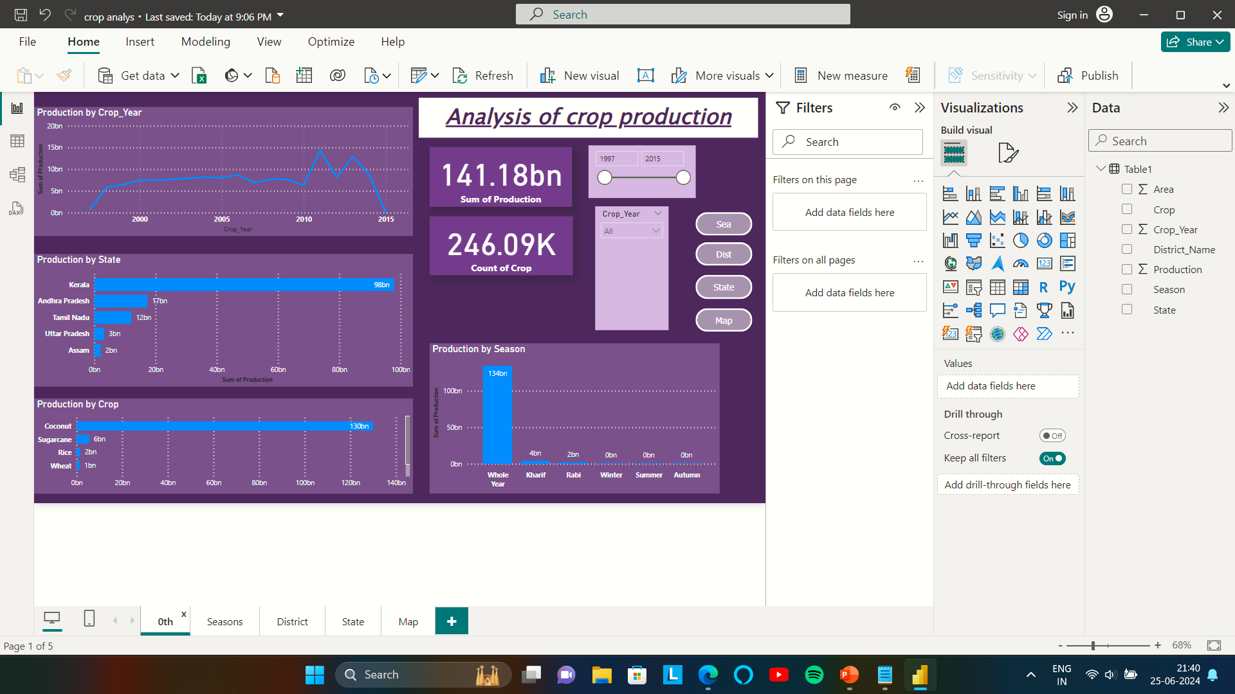
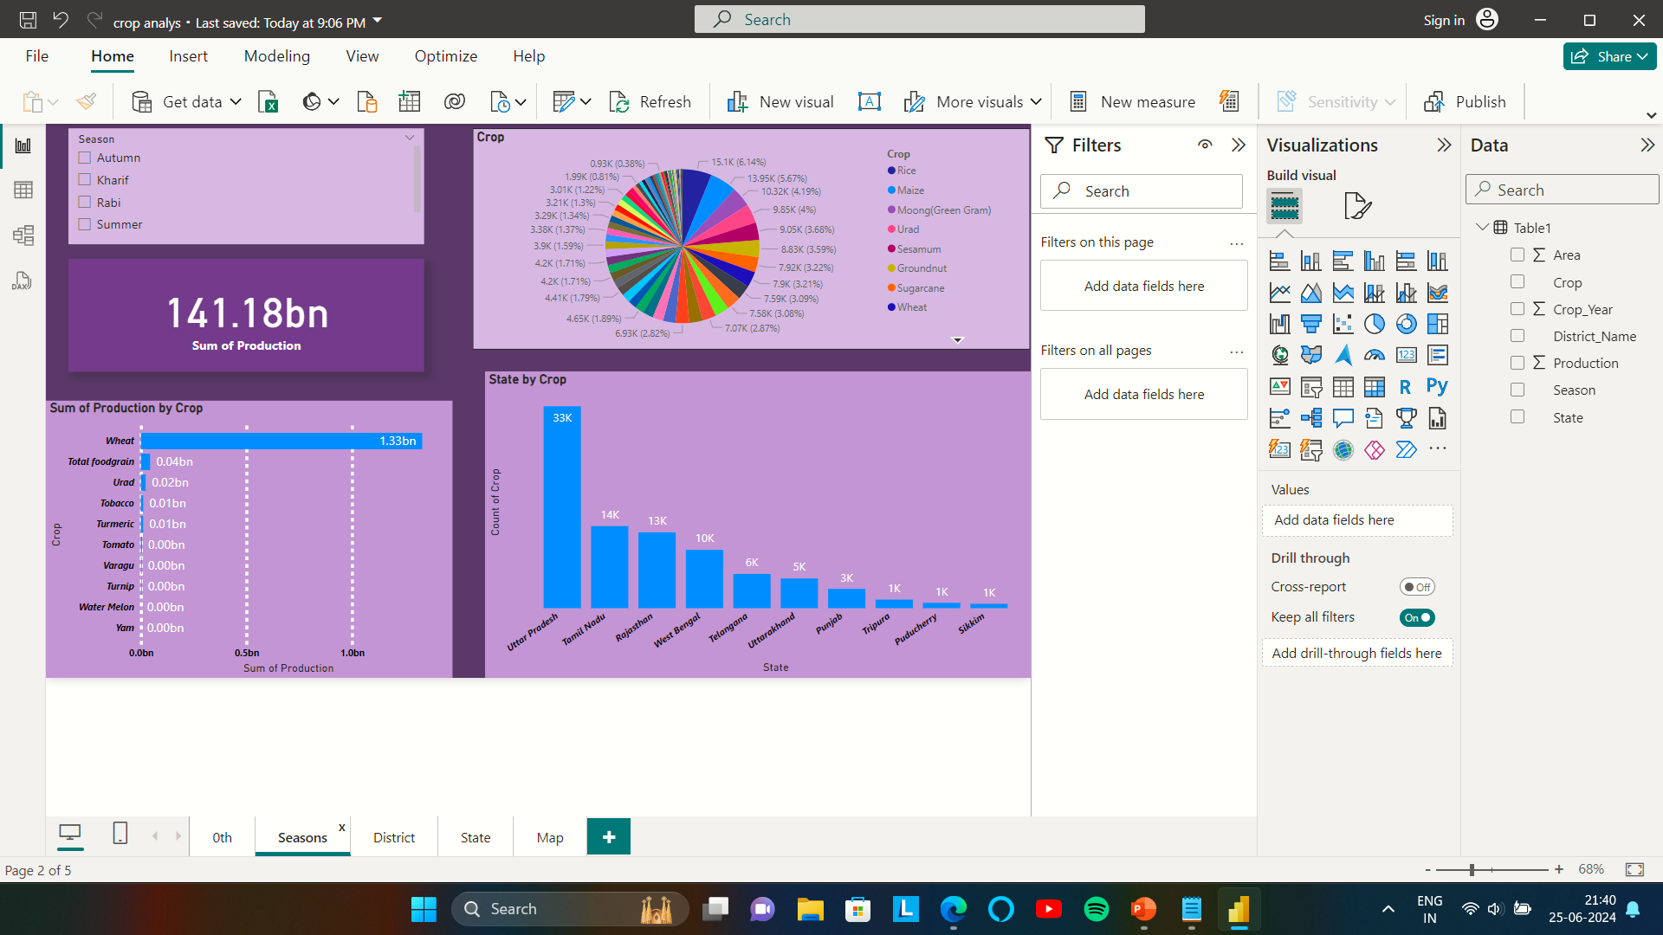
My Design

Slide 6
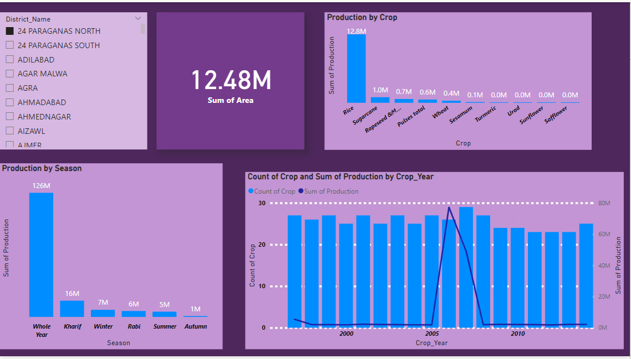
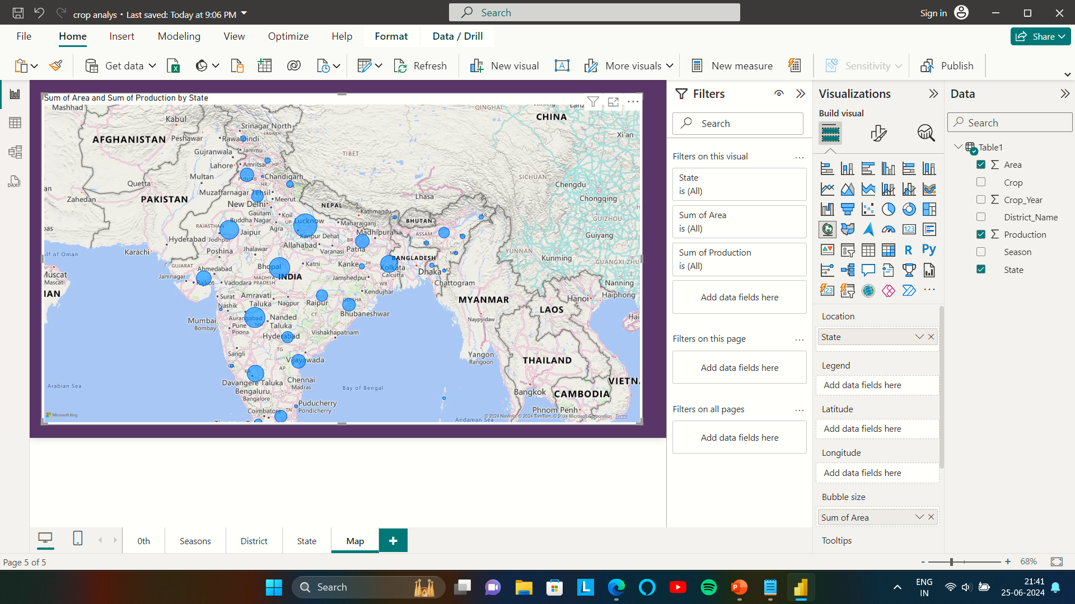
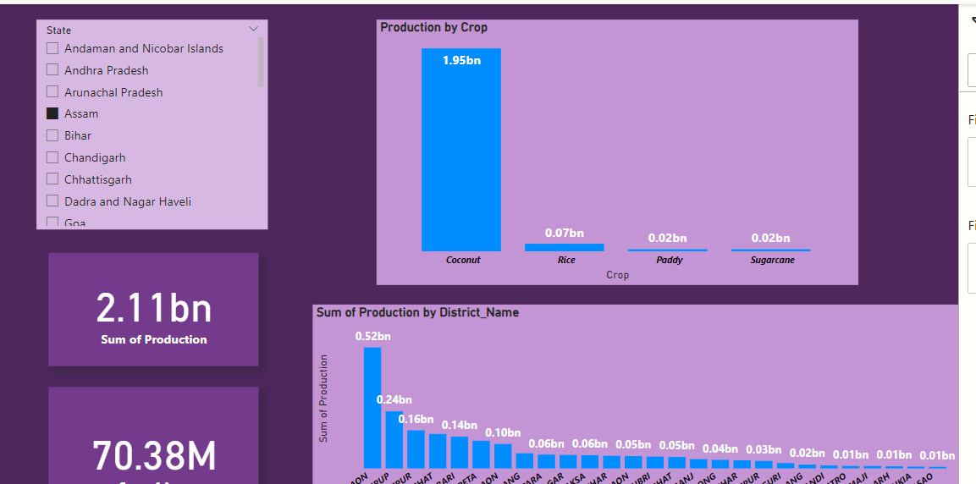
My Design

Slide 7
Insights:-
Kerala, Andhra Pradesh, Tamil Nadu, Uttar Pradesh these are the states which has highest production that is 98bn, 17bn, 12bn, 3bn respectively.
If we see the total production then we observed that coconut has highest production rate that is 130bn and then second is sugarcane which is 6bn.
As per the seasons-
In autumn season:-
The crop which has highest production, that is rice which is 52M.
In this season the states like Bihar, Odisha, West Bengal, Assam, and Kerala, these are the top 5 states which has highest crop production.
And sum of production in Autumn seasons is 64.41M.

Slide 8
In summer season:-
The crops which has highest production are Rice, Sunflower, and sesamum that is 128M, 1M, 2M respectively.
In this season the states like West Bengal, Karnataka, Odisha, Uttar Pradesh, and Maharashtra these are the top 5 states which has highest crop production.
And sum of production in kharif seasons is 170.66M .
So we observed that production in Kharif season is high as compare to other seasons.
As per the District-
In every state some district has high production and total area like Murshidadad, Midnapur west, bardaman from West Bengal .
And muzzfer nagar, kheri, Bijnor from utter Pradesh.
As per States:-
Kerala has highest production rate around 97.88bn.
We also observe that in the year 2011 has highest crop production that is 14.31bn
And second highest production year is 2013 that is 12.9bn.

Slide 9
Thank you

